Slide 1

Online Shopping(floweraura.com)
Bharti Sopan Kalbhor
New arts commerce & science college ahmednagar

Slide 2
Contents
Project Introduction
Company profile
Existing System
AS-IS system limitations
Proposed System
Module Hierarchy Diagram
Entity Relationship Diagram
Data Flow Diagrams(if applicable)
All UML Model(Use case,Sequence,Activity,class etc.)
Screen layouts
Limitations & future Enhancements
Conclusion

Slide 3
Project Introduction
The main purpose to develop this project Online e-Commerce Shopping(floweraura.com) is to sell the flower ,cake , flower pot , gift of birthday , anniversary etc items online. This project is basically develop for pune city for focus on locally . Order flower, cake , and flower pot, gift online with cash on delivery in pune. Order flower ,cake , flower pot , gift online in BD, get home delivery. This project Online e-Commerce Shopping provides all facilities to shopkeeper to manage the shop on website and control the entire e-Commerce business transaction from website. It can also help to shopkeeper keep flower ,cake , flower pot , gift Item for sale as well as can updates from site time to time. This project manages various product category, product, special offer, gallery, order, payment and customer’s feedback. In this project, customers can easily view various product, add to cart product, place order. We have developed many modules in the project for performing all the operations of this system. Some of the modules are product management, type management, order management etc.

Slide 4
Company Profile
ABOUT OUR COMPANY :
BUSINESS PROFILE:
“GTL Software” is a leading software development company with office in Pune. Establishing GTL Software from 2010 aimed to provide an informal yet highly professional environment to our workforce and nurture them towards identifying the organization’s goals as their personal targets.
To provide efficient and cost-effective solutions to complex information management requirements through innovative application of the latest in technology. To achieve excellence in every sphere of operation.
Our Aim
“To be automated and to see automated”.
We are highly motivated to provide professional software with high quality.

Slide 5
Existing System
In existing system for giving any orders, users should visit product shop to know about product, give them order, and pay advance. In this method, time and manual work is required. Maintaining critical information in the files and manuals is full of risk and a tedious process. The existing system serve a major drawback to the realization of efficiency and customer satisfaction. The experience of ordering in most shop is not pleasant for the customers

Slide 6
Scope of the system:
Purchasing and selling products and services over the internet without the need of going physically to the market is what online shopping all about. Online shopping stores offer product description, pictures, comparisons, price and much more. Few examples of these are Amazon,flipcart and the benefits of online shopping is that by having direct access to customer. Online shopping makes use of digital technology for managing the flow of information, products, and payment between customer, site owners and suppliers. shopping cart is one of the important facilities provided in online shopping, this lets customer to browse different types of product and services and once they select an item to purchase, they can place the item in shopping cart, and continue browsing till the final selection. Customers can even remove the items from shopping cart that selected earlier before they place the final order.

Slide 7
Proposed System
OBJECTIVES OF SYSTEM
A Online Shopping is a web Application where the User can register themselves and online Purchase item main Objective of this system is maintaining the Products online and provide online payment facility to customer or cash on delivery facility. The objective of the system is to provide the customer with on-the-click functionality that helps them to search over a variety of products at a centralized location and buy the products that best suit their requirements in an easier and faster fashion. The software system designed in such a way that anyone can view the updates of the products being offered on the website at any time that too easily. The software will help in easy maintaining and updating flowers, cakes etc products in the website for the administrator.
.

Slide 8
PRODUCT OVERVIEW
In the Online Shopping, system provides customer to order the new and fresh product. User can search the product or add the product to shopping cart or order the product if he/she want. Customer can pay the bill online or cash on delivery. Search the item on site and if order placed for product then customer have to register and then place order. Save the money or time of customer. Delivery boy deliver the product to customer and give the bill from customer if the payment type is cash on delivery and guest user only search the product or add in the shopping cart.

Slide 9
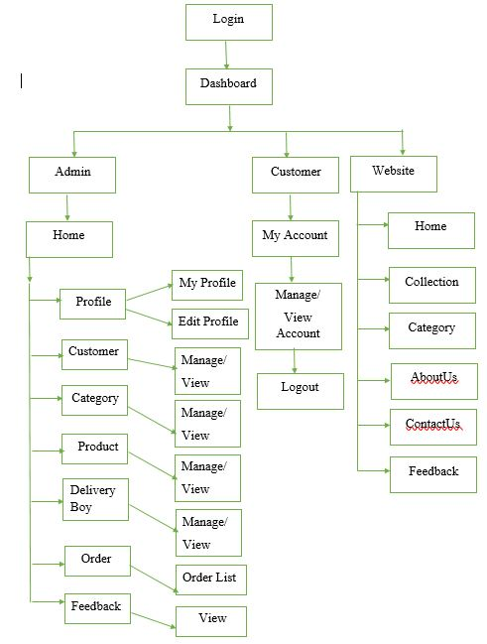
Module hierarchy diagram

Slide 10
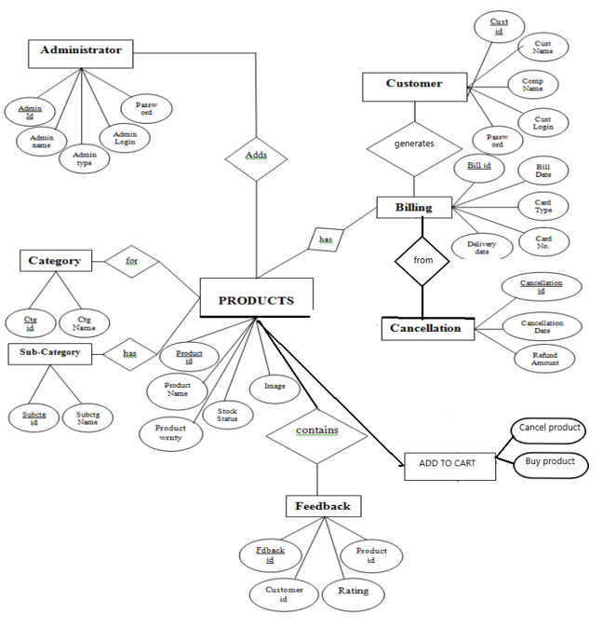
Entity Relationship Diagram

Slide 11
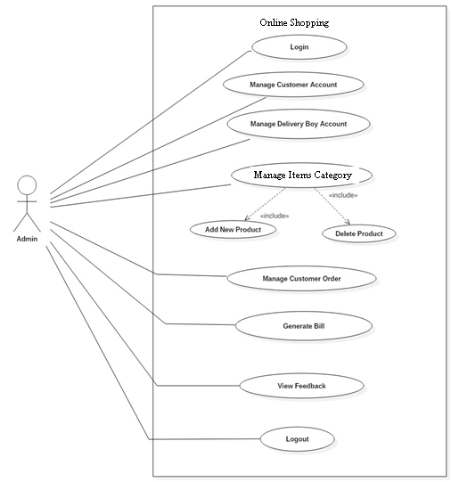
Use Case Diagram:
Admin :
<College_name> <Degree/Year> <Project>

Slide 12
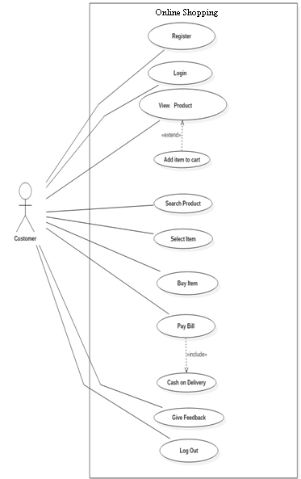
Customer Use case:

Slide 13
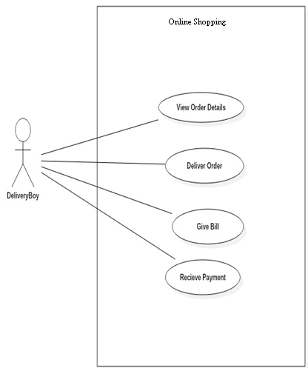
Delivery Use case:
<College_name> <Degree/Year> <Project>

Slide 14
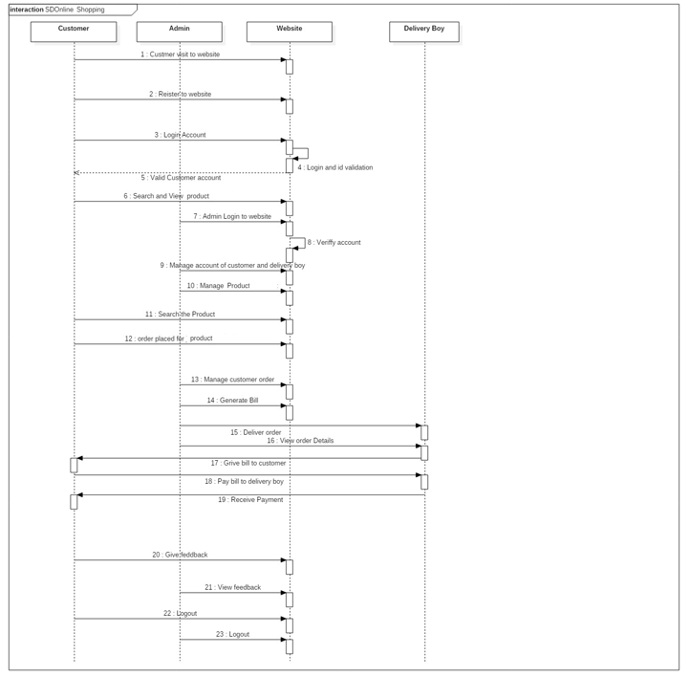
Sequence diagram:

Slide 15
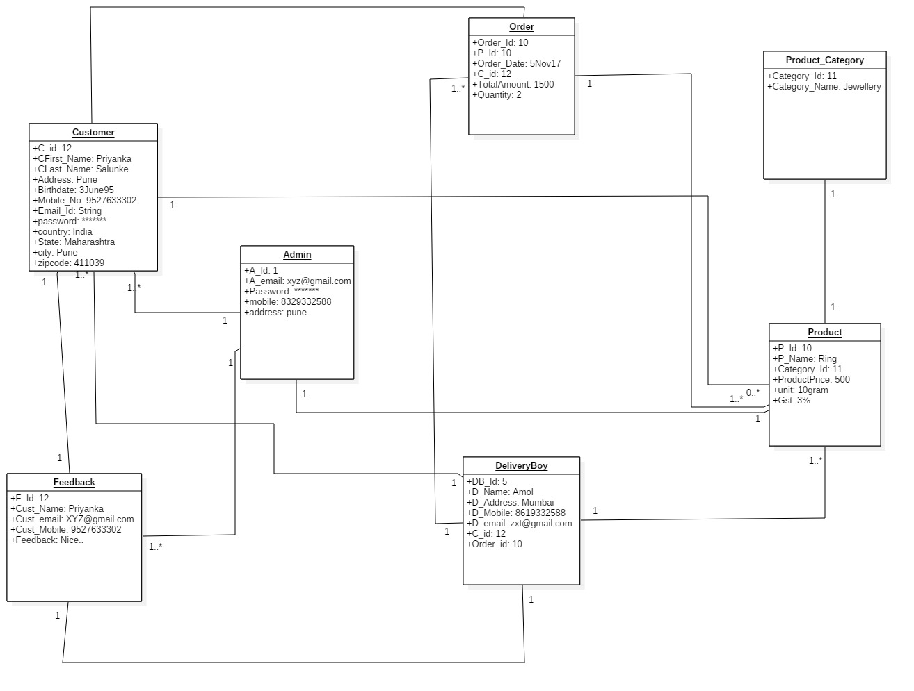
Object Diagram:

Slide 16
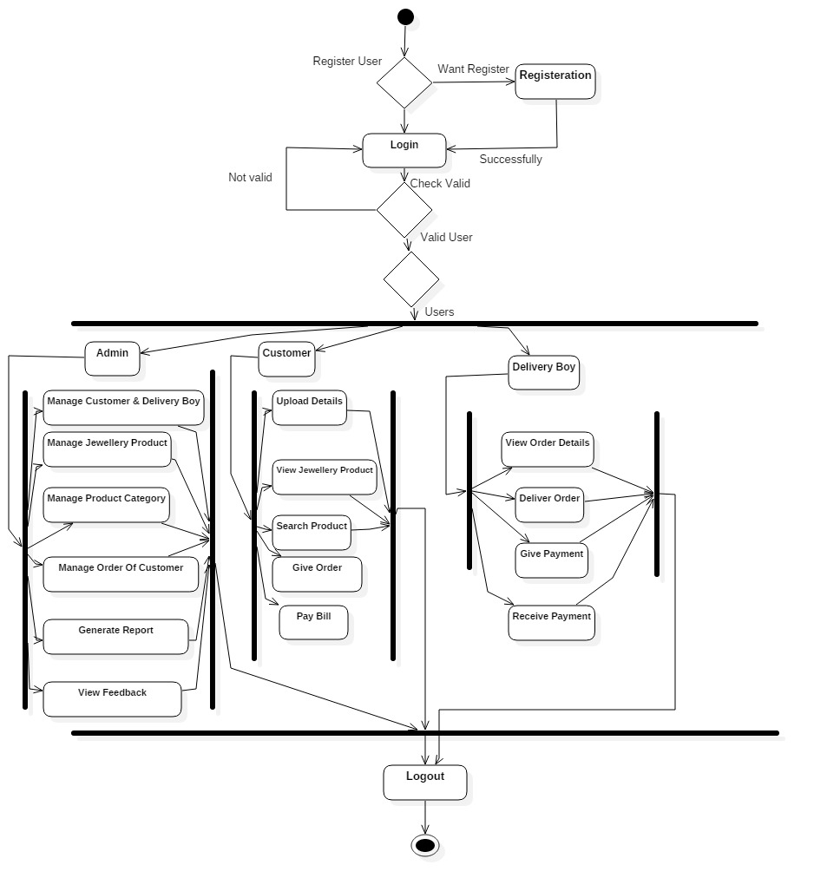
Activity Diagram:

Slide 17
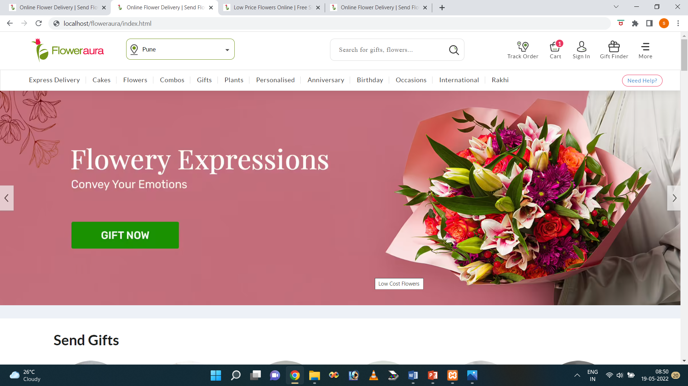
Screen Layouts
Home:

Slide 18
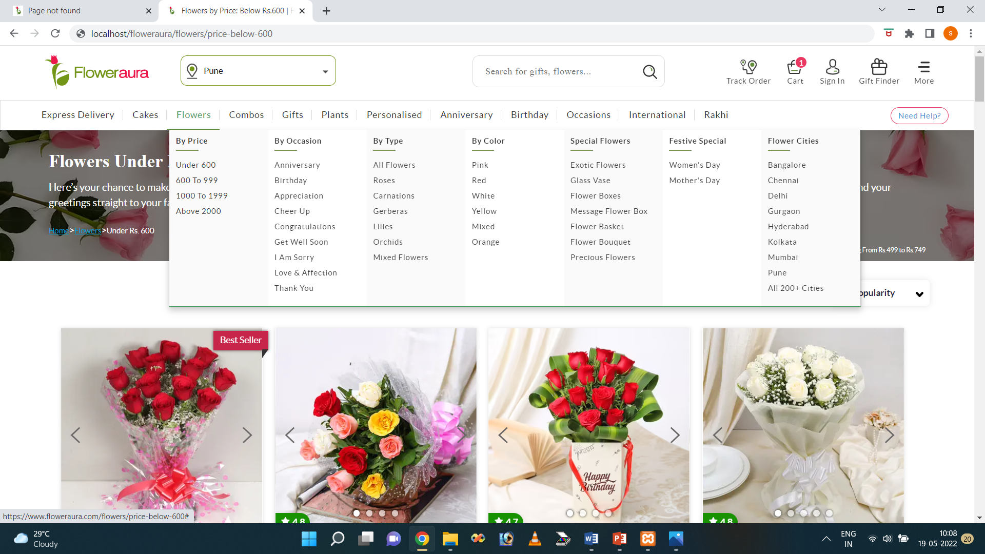
Category:

Slide 19
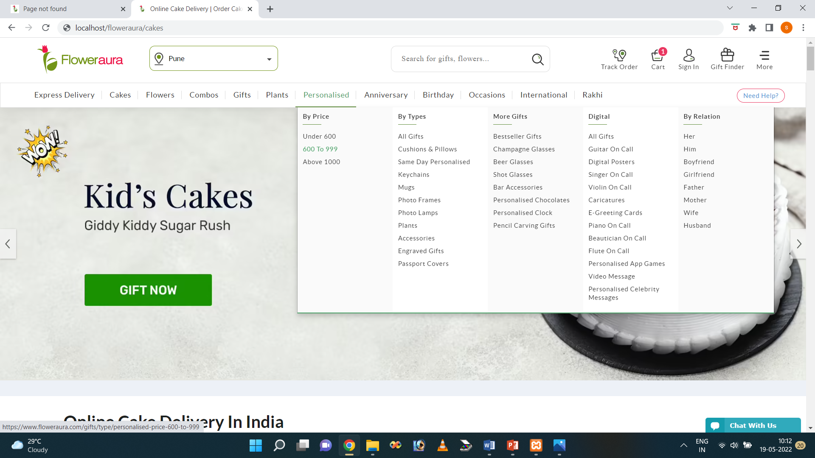
Category:

Slide 20
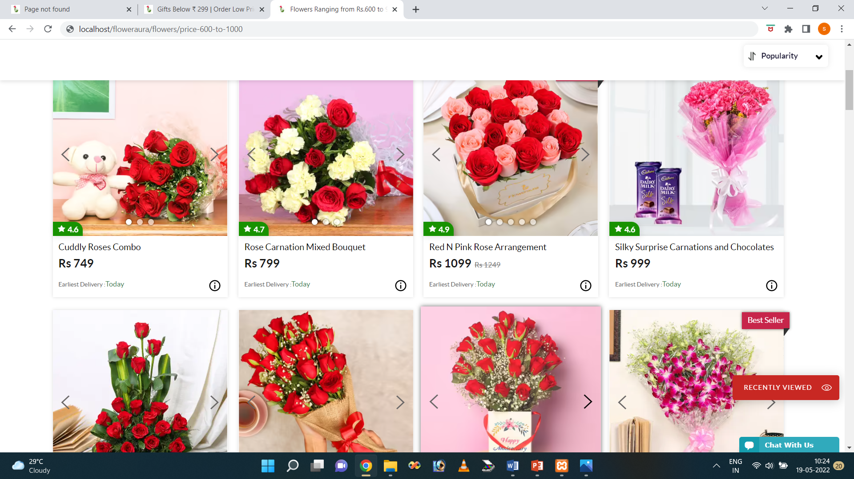
Products:

Slide 21
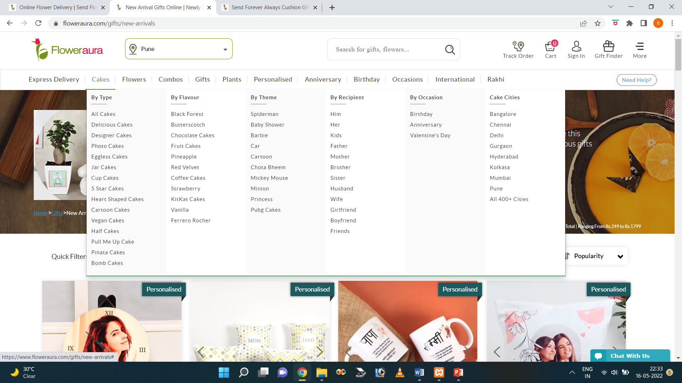
Product list:

Slide 22
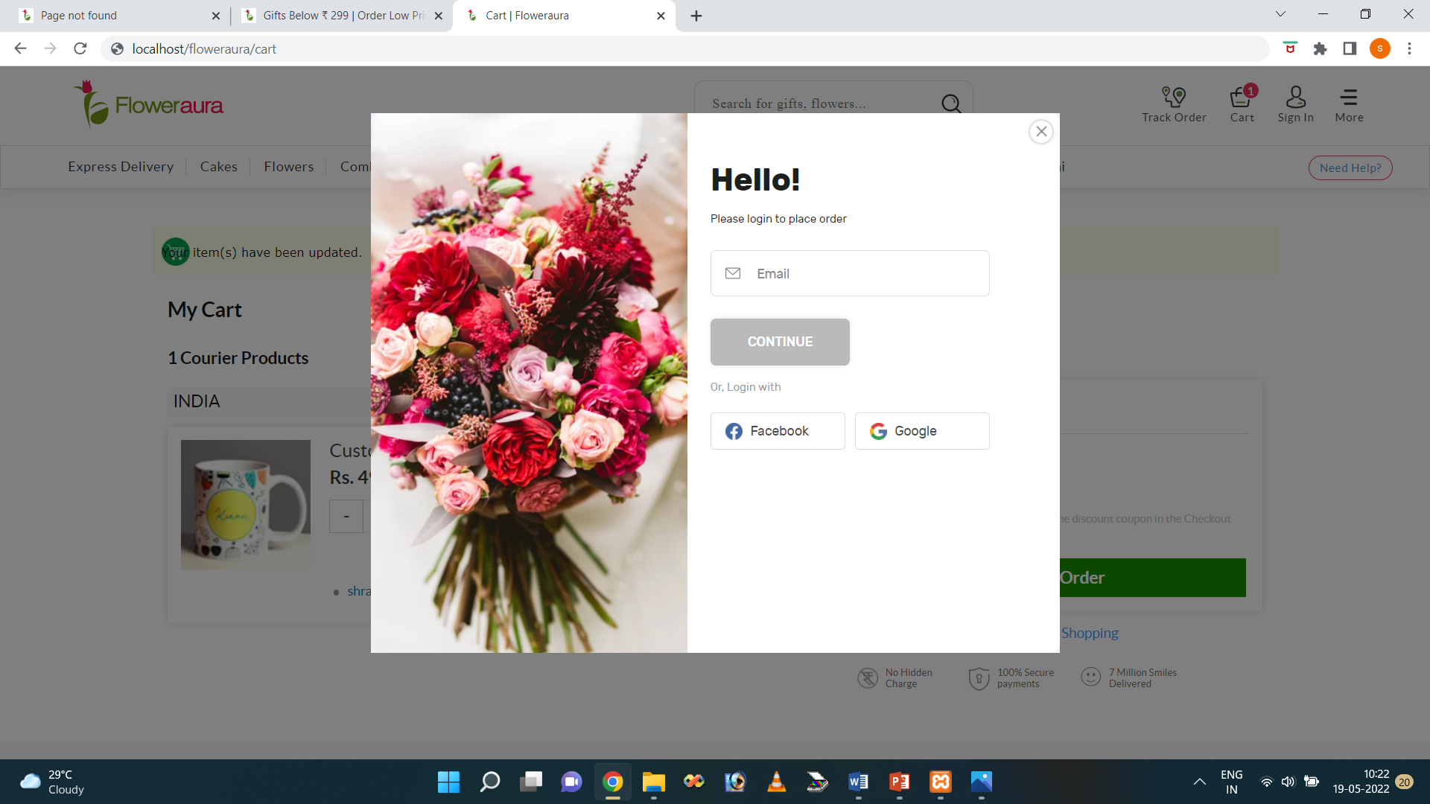
Customer login:

Slide 23
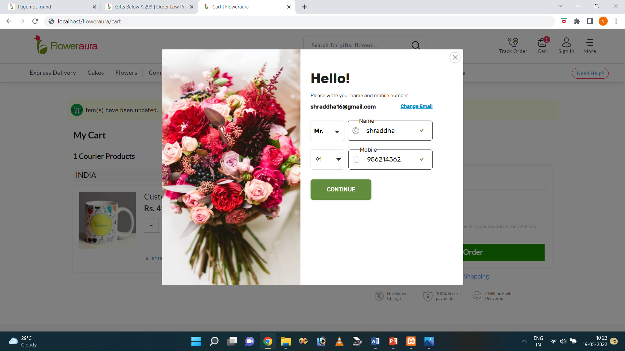
Customer login:

Slide 24
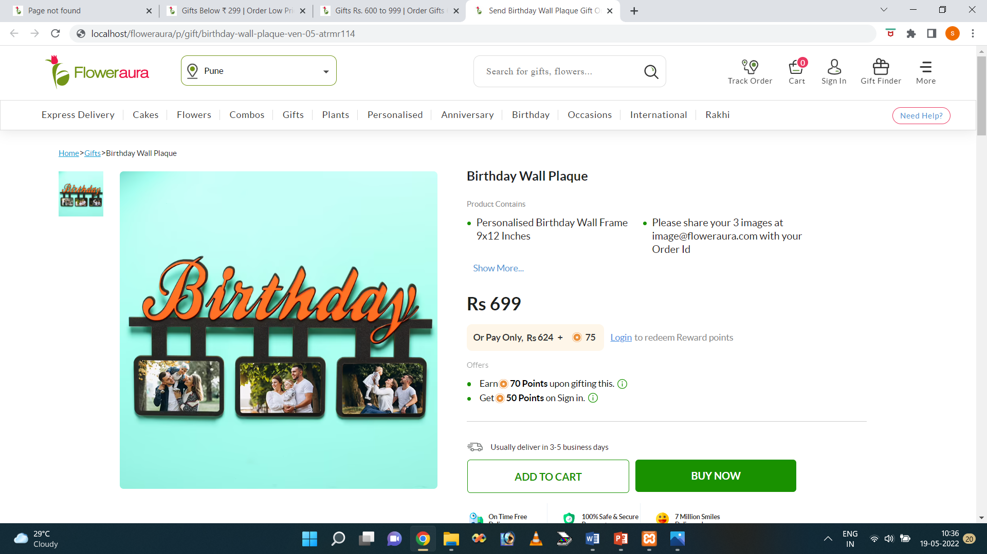
Product details:

Slide 25
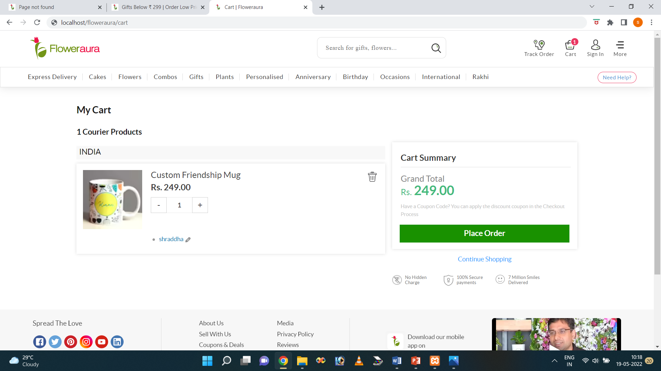
Customer ordre:

Slide 26
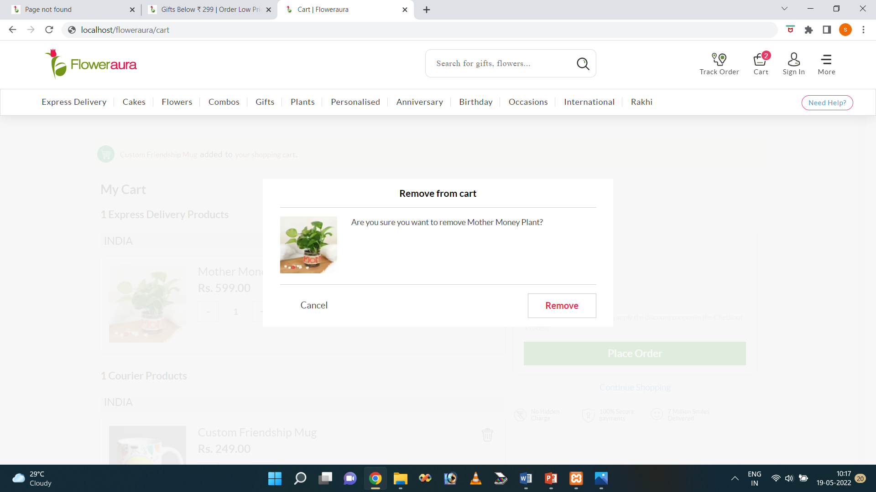
Delete product:

Slide 27
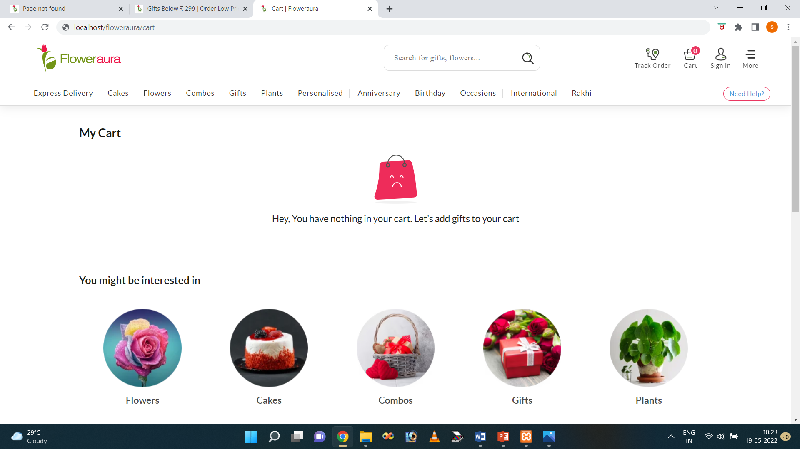
Empty cart:

Slide 28
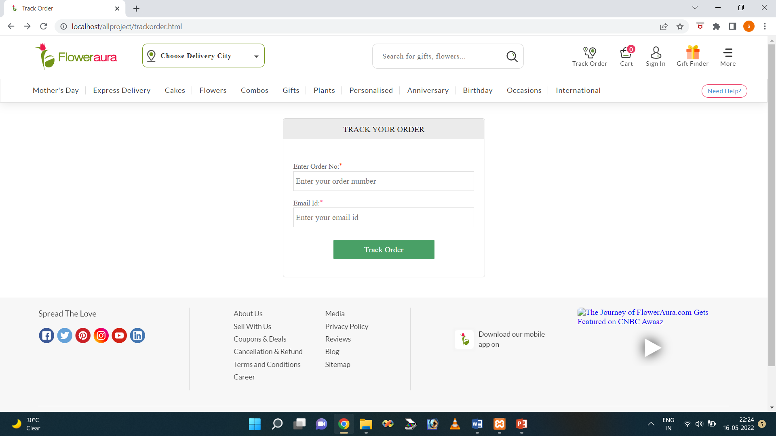
Track your order:

Slide 29
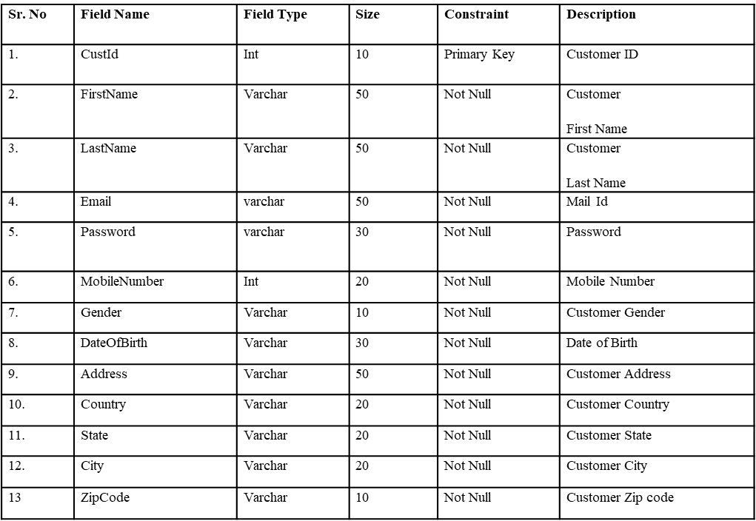
Data dictionary customer:

Slide 30
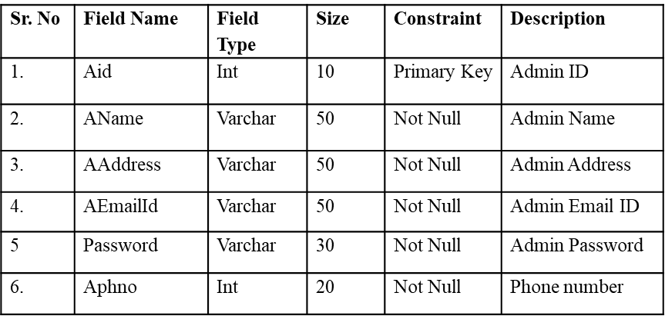
Admin:

Slide 31
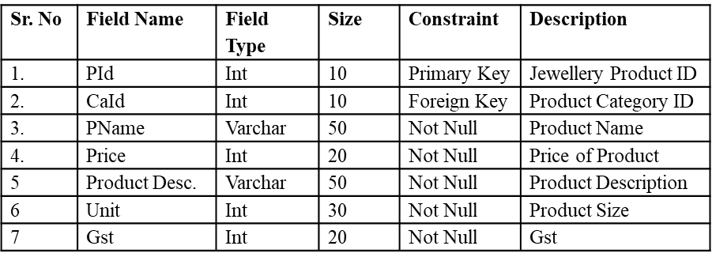
Product:

Slide 32
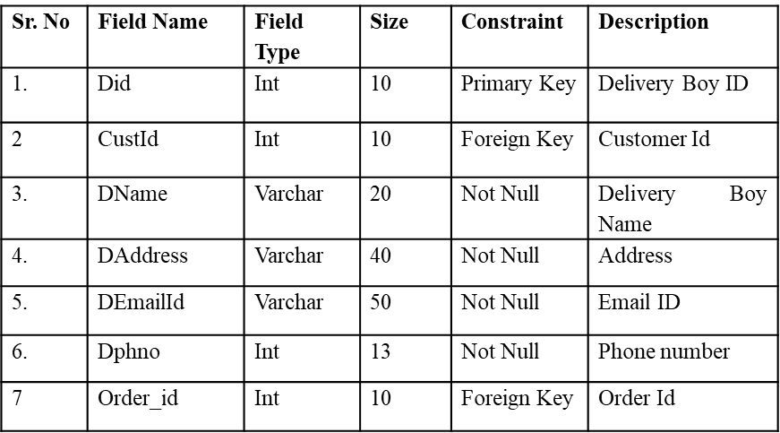
Delivery boy:

Slide 33
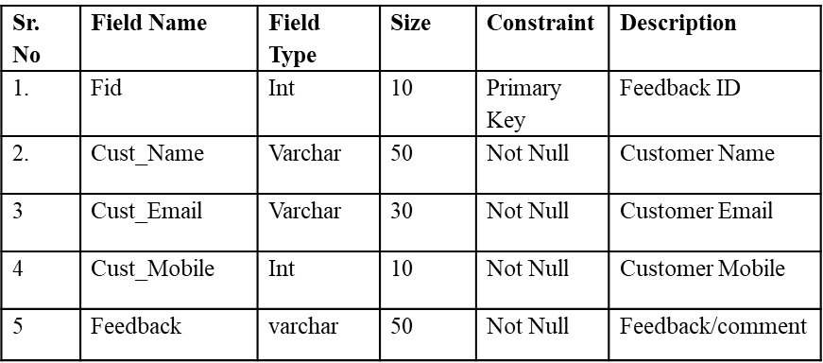
Feedback:

Slide 34
Future Enhancements
In future, we provide search facilities like category wise searching or price wise searching.
Provide notifications to user about offers and discounts.
Higher security can be included in payment.
Chatting module will be implemented.

Slide 35
Conclusion
It concludes that people have substituted their needs to shop at local stores by all gift items /cakes / books etc shopping online. Customer is the king for every business and nobody wants to lose the profitable customers. The online shopping system provides various features to your customers to keep in the list of your 'regular customers’. Customers can enjoy the convenience of ordering Product online while sitting at their homes/offices.
The Online shopping System upload their jewellery product online so that they can be easily managed or changed and customers can order online.

Slide 36
Thank you

